Slide 1
FAKE NEWS DETECTION USING NLP
Group Members:
D.SANDHIYA
P.PRIYADHARSHINI
S.SRIABI
R.NAVEENA

Slide 2


What Is Misinformation
Misinformation
Fake News
Parody

Slide 3

Misinformation | False or inaccurate information, especially that which is deliberately intended to deceive | Oxford English Dictionary
Publication Errors / Corrections | is an action, statement, or publication which is inaccurate or incorrect. Reputable news sources usually publish corrections or retractions. | Poynter.org
Satire | noun 1. the use of irony, sarcasm, ridicule, or the like, in exposing, denouncing, or deriding vice, folly, etc. | Dictionary.com
Propaganda | the spreading of ideas, information, or rumor for the purpose of helping or injuring an institution, a cause, or a person | Mirriam-Webster
Filter Bubble | A bias created when algorithms predict what results a user wants to see based on information about their location, previous searches, likes, and more. | Filter Bubble
Fake News | propaganda consisting of deliberate inaccuracies, misinformation, or hoaxes spread via traditional print and broadcast news meant to mislead or trigger an emotional response and reaction
Echo Chamber | An environment in which a person encounters only beliefs or opinions that coincide with their own, so that their existing views are reinforced and alternate ideas are not considered. | Oxford Dictionary

Slide 4



Misinformation | False or inaccurate information, especially that which is deliberately intended to deceive | Oxford English Dictionary
Publication Errors / Corrections | is an action, statement, or publication which is inaccurate or incorrect. Reputable news sources usually publish corrections or retractions. | Poynter.org
Satire | noun 1. the use of irony, sarcasm, ridicule, or the like, in exposing, denouncing, or deriding vice, folly, etc. | Dictionary.com
Propaganda | the spreading of ideas, information, or rumor for the purpose of helping or injuring an institution, a cause, or a person | Mirriam-Webster
Filter Bubble | A bias created when algorithms predict what results a user wants to see based on information about their location, previous searches, likes, and more. | Filter Bubble
Fake News | propaganda consisting of deliberate inaccuracies, misinformation, or hoaxes spread via traditional print and broadcast news meant to mislead or trigger an emotional response and reaction
Echo Chamber | An environment in which a person encounters only beliefs or opinions that coincide with their own, so that their existing views are reinforced and alternate ideas are not considered. | Oxford Dictionary

Slide 5


Filter Bubble | A bias created when algorithms predict what results a user wants to see based on information about their location, previous searches, likes, and more. | Filter Bubble
Fake News | propaganda consisting of deliberate inaccuracies, misinformation, or hoaxes spread via traditional print and broadcast news meant to mislead or trigger an emotional response and reaction
Echo Chamber | An environment in which a person encounters only beliefs or opinions that coincide with their own, so that their existing views are reinforced and alternate ideas are not considered. | Oxford Dictionary

Slide 6
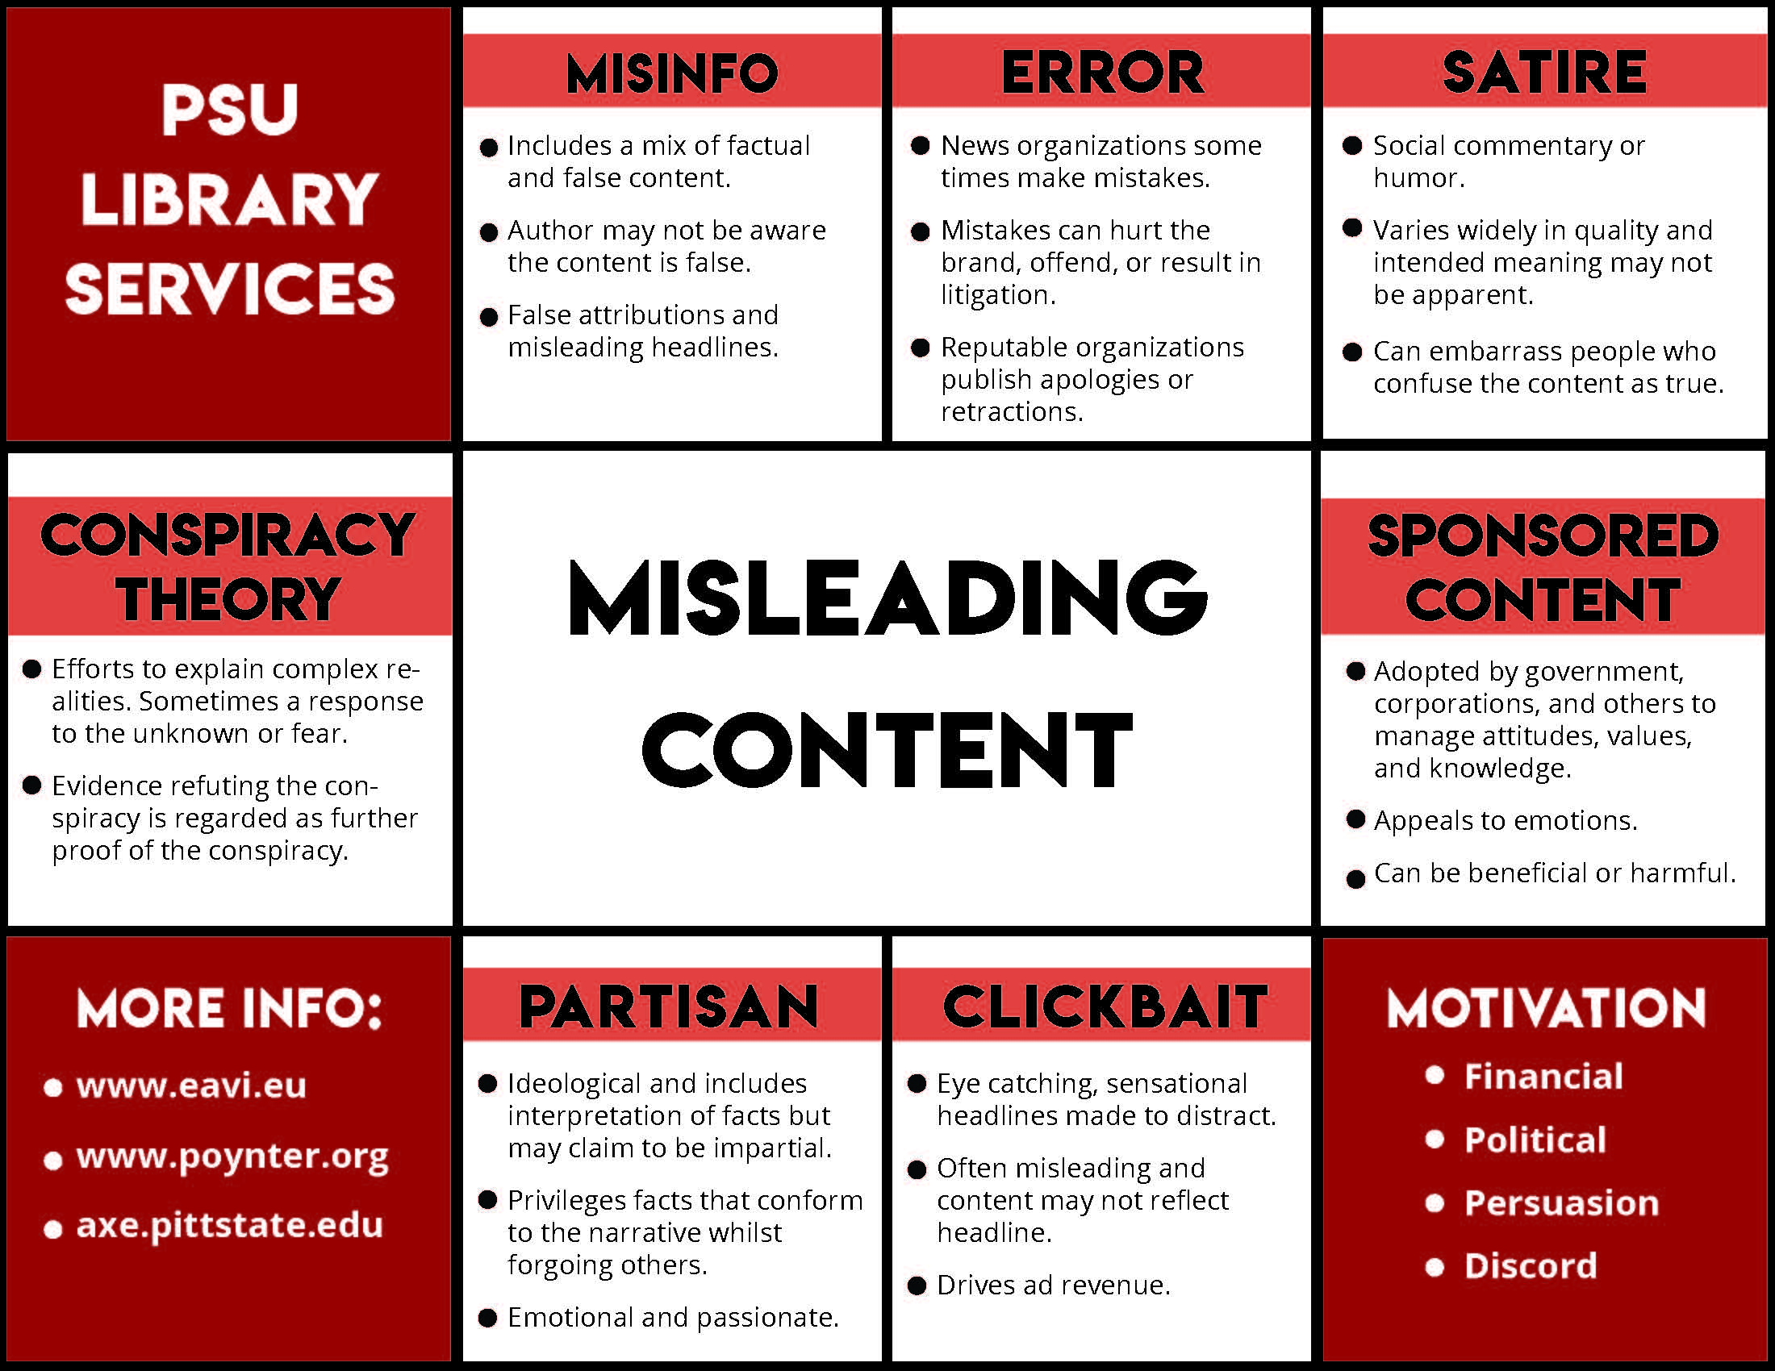

Slide 7
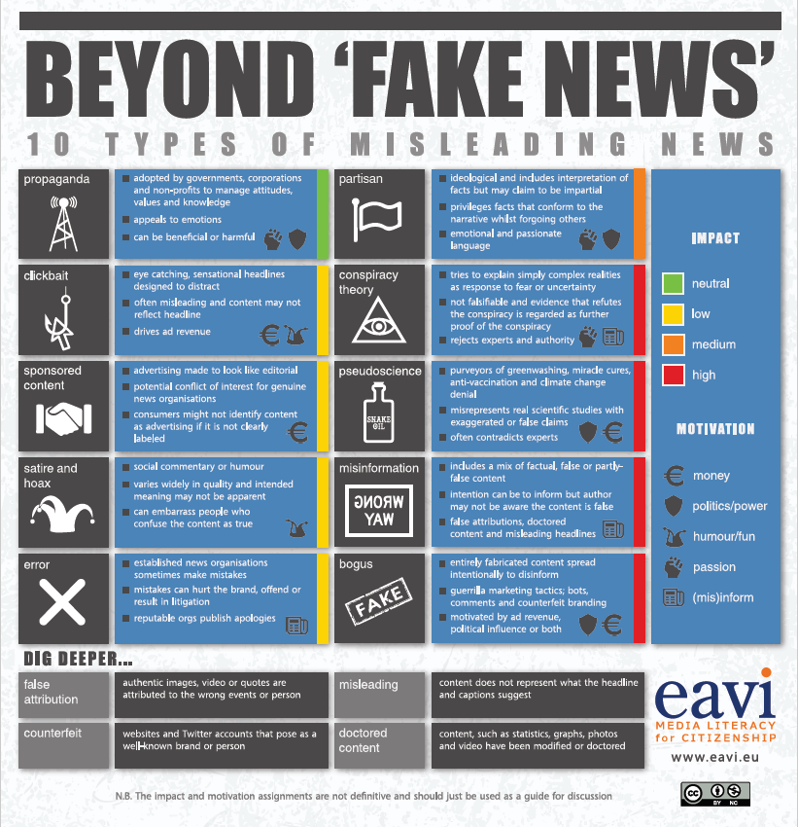

Slide 8
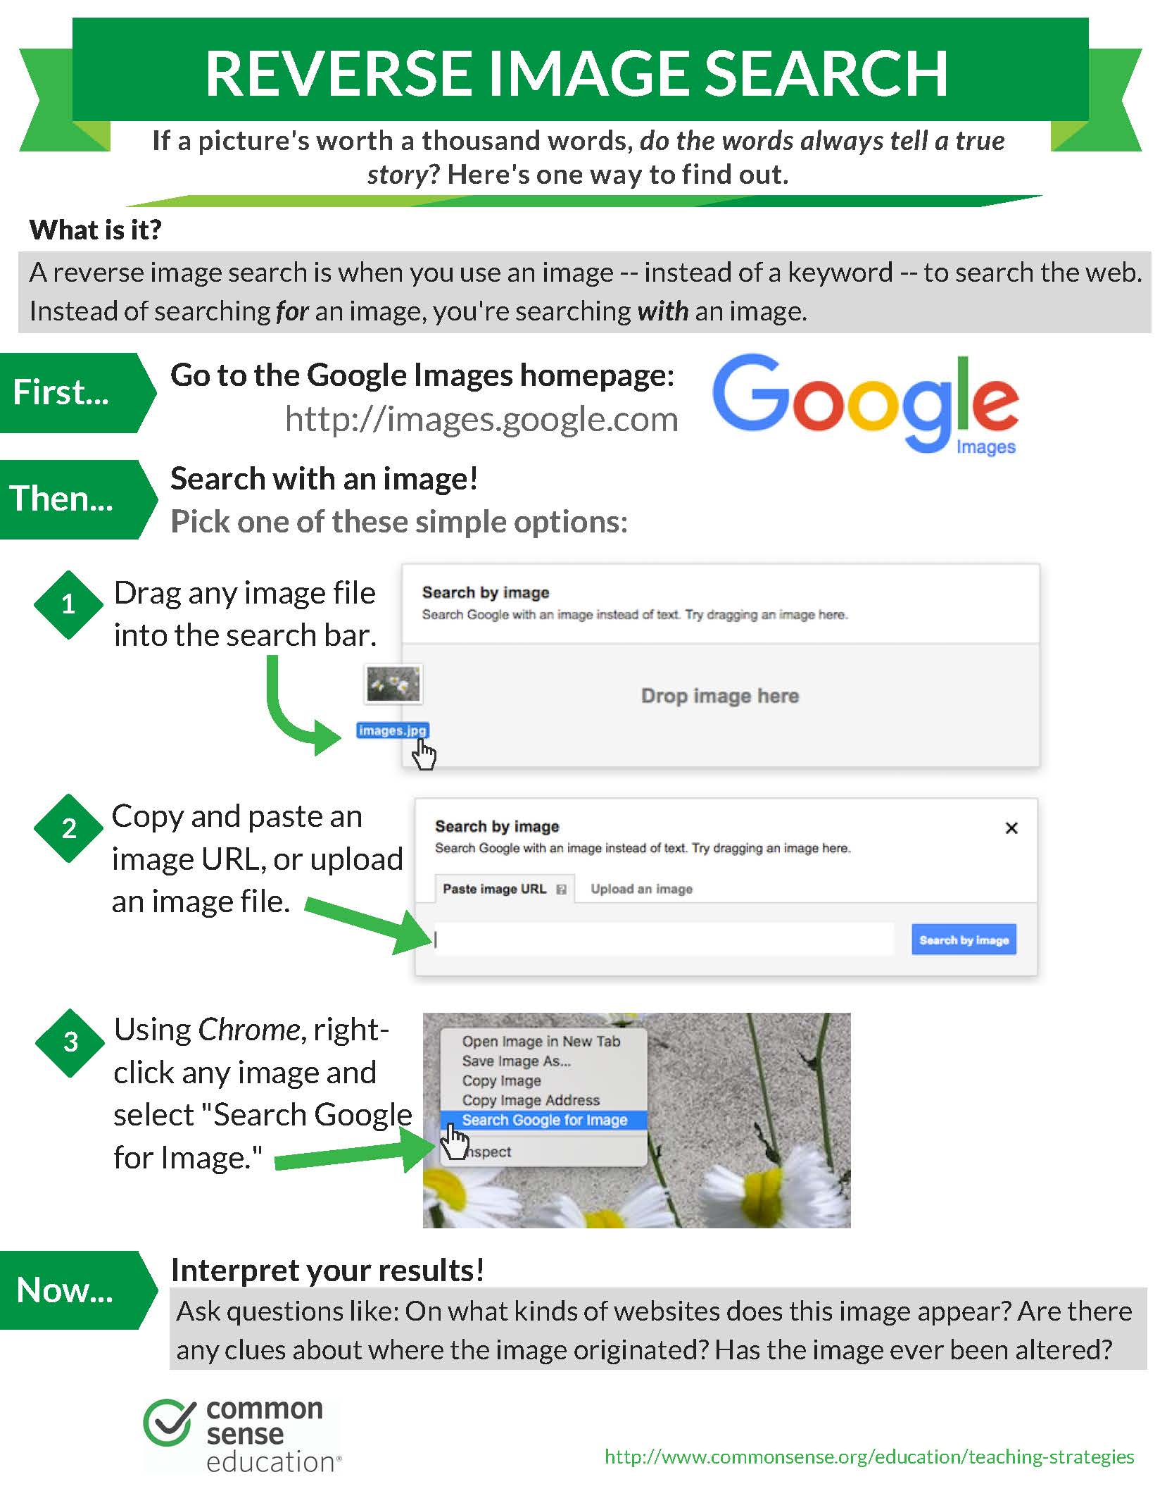
Fact Checking: Images
Images are powerful tools. They can:
Help sell a story
Create strong emotional response
Confirm a narrative
Create doubt

Slide 9
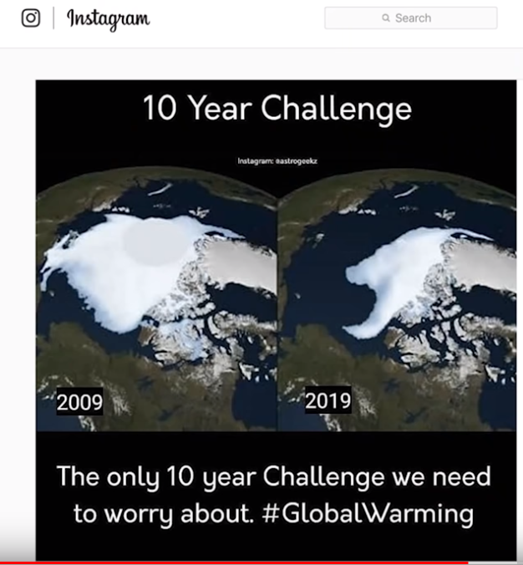
Check if images have been altered or context removed

Slide 10
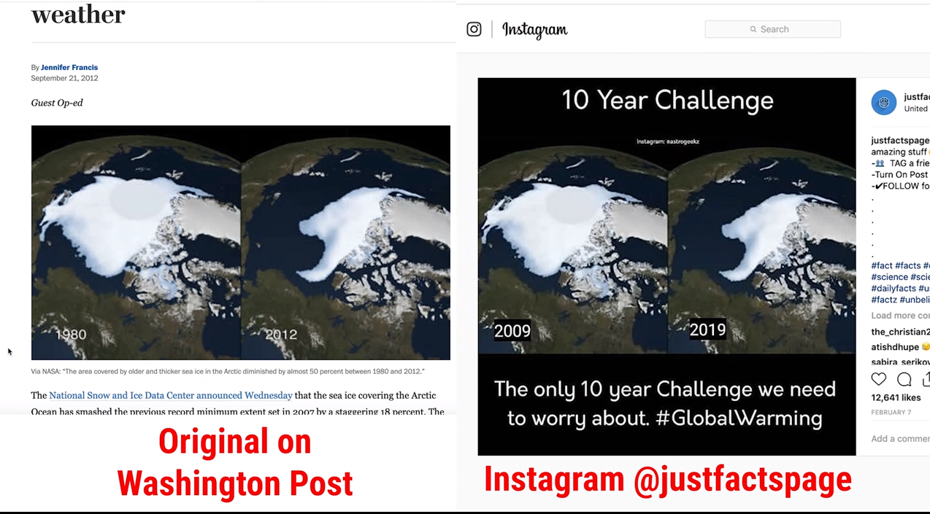

Slide 11
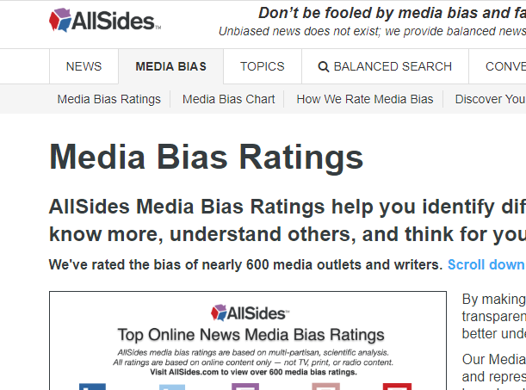

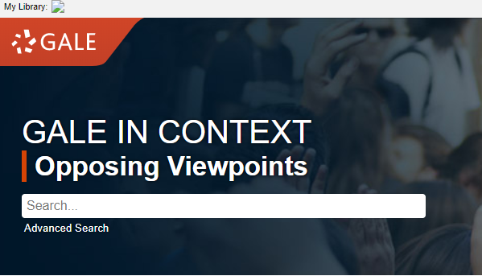
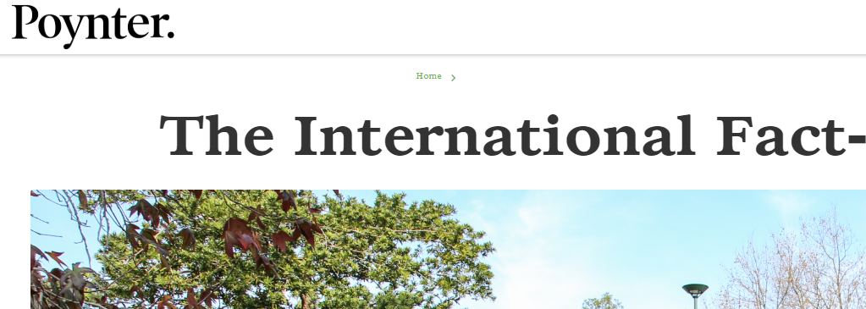
Fact Checking: Sensational Headlines
Fact Checkers
Different perspective

Slide 12


